Slide 1
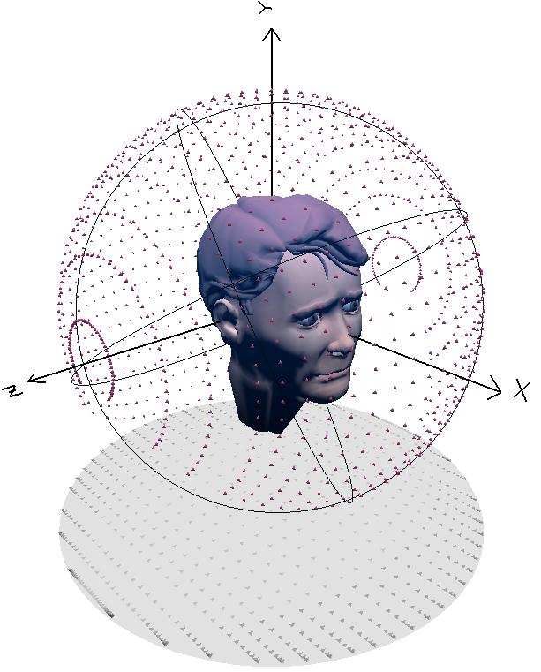
Spatial Audio
Beyond stereo

Slide 2
Why Spatial Audio beyond stereo
Be immersed in a film world
Feel you are the game character
Re-live your favourite concert
Envelopment – 2D attribute
Engulfment – 3D attribute

Slide 3
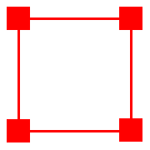
Early Attempts: Quadraphonic
Speaker spaced too far apart
Sounds are pulled towards speakers
Overall a worse experience than stereo
Proved inadequate by Michael Gerzon

Slide 4
Five-channel surround sound system
5 Full bandwidth channels
Low Frequency Extension channel
Positioned anywhere
All speakers equidistant
Variations with rear channel at +/-135
Large Gap between surround channels
C
L
R
30⁰
30⁰
110⁰
110⁰
LS
RS
Quadraphonic and surround sound use level differences between two closest loudspeakers, like stereo panning.

Slide 5
Constant power panning for five channels
(top) channel gains, (bottom) total power and total gain

Slide 6
Gerzon on quadraphonic sound
aim of 4-channel stereo is (or should be) to recapture as many as possible of these missing qualities of live sound in the home… only a few of these qualities have been captured, some new deficiencies have been introduced which are absent in ordinary stereo. … excessive quantity of reverberation … lack of precise directional information, lack of any sound from the sides of the listener, absence of height information, distracting echoes from behind the listener, lack of that sense of perspective which makes the orchestra appear to be at a natural distance from the listener. … sound heard is generally muddy and confused, and is less satisfying than ordinary old-fashioned stereo.
– condensed from Whither Four Channels? , Michael Gerzon, 1971

Slide 7
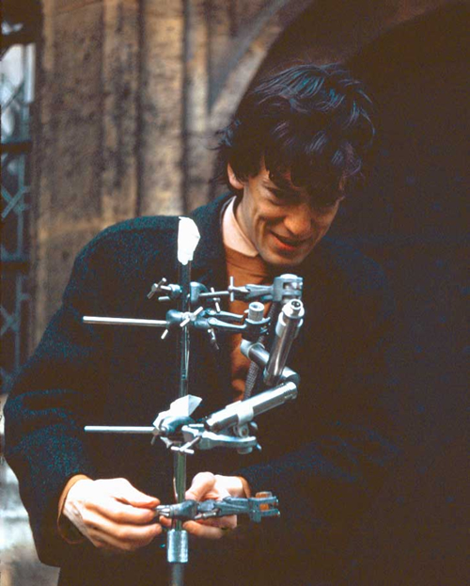
Ambisonics
Developed in the 1970s by Michael Gerzon
Based upon Spherical Harmonics
Often uses standard 3D speaker-independent representation of a sound field, B-format
Higher order gives better spatial resolution

Slide 8
Standard depiction of the coordinate system in 2D ambisonics.
Plane
wave
x axis
Listener
ψ
r
φ
y axis

Slide 9
Four loudspeakers arranged in a regular layout, suitable for first order, 2D ambisonics.
Goal is to approximate the plane wave, and then map the approximation to signals sent to each loudspeaker

Slide 10
A typical ambisonics layout. Five loudspeakers arranged in a regular layout, suitable for second order, 2D ambisonics.

Slide 11
The complicated math
Plane wave P_{ψ} arriving at listener
Plane wave expanded as series of cosines and Cylindrical Bessel Functions
each loudspeaker produces plane wave output
output of n^{th} speaker
φ_{n} is angle of n^{th} speaker
Summing over N speakers gives total reproduced wave
Terms should match

Slide 12
Matching conditions
First order
So can apply gain to each loudspeaker is

Slide 13
This is better understood with an example
,
2D, first order ambisonics with loudspeakers at 0, 90, 180 and 270 degrees. Find gain for each loudspeaker, given plane wave source at an angle ψ.
Ambisonics matching conditions for
plane wave arriving from angle ψ:
Feed to n^{th} loudspeaker in 1st order N
loudspeaker ambisonic system

Slide 14
Example
,
Find gains for 4 loudspeakers, given plane wave from ψ.
, So
Now just put the terms in for W, X and Y.

Slide 15
Ambisonics properties
2D Nth order ambisonics requires 2N+1 loudspeakers
It can use just 3 loudspeakers
3D Nth order ambisonics requires (N+1)² loudspeakers
Can be adapted to directional loudspeakers, nonplanar sources…
In theory, great. But in practice, suffers from small ‘sweet spot’ due to precedence effect and other factors

Slide 16
Vector Base Amplitude Panning (VBAP)
Like stereo panning
Uses a triplet of speakers to localise a source (3D)
Same as tangent law (2D)
Calculate speaker triplet vector same as the point source
Pulkki, Ville. "Virtual sound source positioning using vector base amplitude panning." Journal of the audio engineering society 45.6 (1997): 456-466.

Slide 17
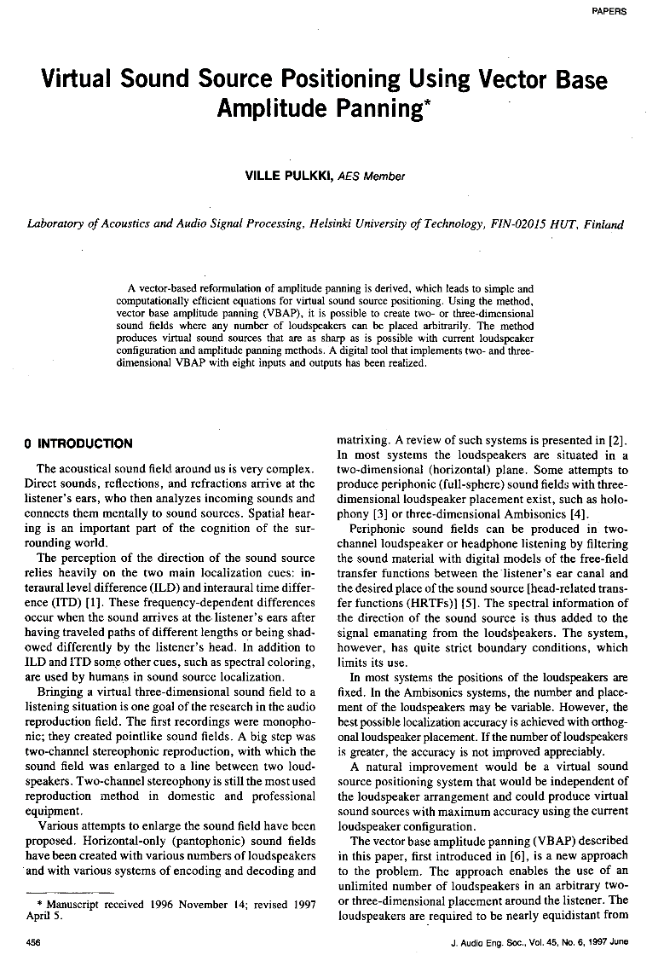

Ville Pulkki – inventor of VBAP
1997
Now

Slide 18
Calculating VBAP Gains
P – point source
L – loudspeaker locations
Can also calculate gains of triplet using simultaneous equations or Cramer’s Rule
Notes:
The gains for speakers 1, 2 and 3 are calculated by multiplying the transform of the point source by the inverse matrix of the loudspeaker locations. Of course when using a 3D speaker array there are more than 3 speakers and the formula is applied to the active triplet. An active triplet is simply chosen by the triplet that the point source lies within. Once the gains have been calculated they are then normalised. There are alternates for calculating the gains such as simultaneous equations or Cramer’s Rule.

Slide 19
Wavefield Synthesis
More and more loudspeakers
Go back in time…

Slide 20
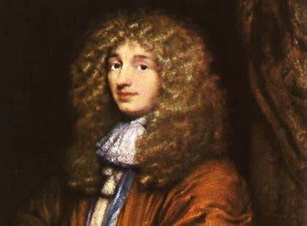
Illustration of Huygens' principle.
Source
Secondary
Sources

Slide 21
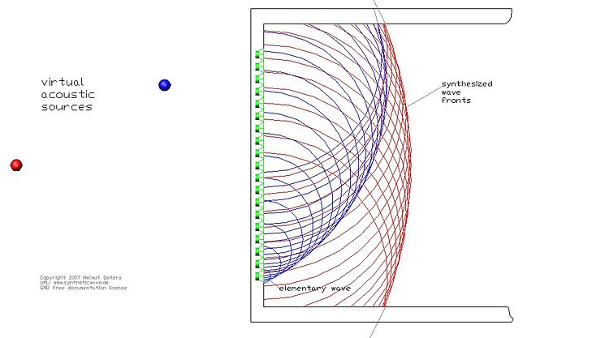
Wave Field Synthesis
Reproduces wave fronts
Highest frequency is determined by speaker distance
Downside is the amount of loudspeakers and cost

Slide 22
Geometry for the calculation of the driving functions, given a virtual source behind a line of loudspeakers.
Secondary
Source
r
Listeners
θ
b
Source
a

Slide 23
Spatial aliasing
Just like not sampling enough in the frequency domain, WFS may not sample enough in the spatial domain
Condition to avoid spatial aliasing of a frequency f for a plane wave of angle of incidence φ
Roughly 2cm separation between loudspeakers for alias-free rendering over the whole frequency range
Luckily, we are not very sensitive to spatial aliasing

